Slide 1
Welcome!!
Your microphone will be muted most of the session.
You may choose to have your video on or off.
Please Rename yourself as follows: FirstName LastName – Institution Name
If you have questions for the panelists
Please type them in the chat area. We will do our best to address any not answered during the presentation at the end.
Evaluation & PowerPoint
These will be in the chat area at the end of the presentation.
This workshop will be recorded.
(Link will be posted on the public PACAC website.)
**Any attendee who completes the entire workshop today will receive a Certificate of Completion via email.

Slide 2
Professional Development, Collaboration, Advocacy, Support, and Friendship

Slide 3
Reminder
As with all PACAC Presentations, the inclusion of any presenter or content is not an endorsement by PACAC or any of its representatives.

Slide 4
Lunch & Learn Session II:
Influencing Your Personal Sphere Towards Inclusivity & Equity
Candace Leake, Bucknell University
Sofia Fallas, Saint Joseph’s University
Notes:
Sofia & Candace

Slide 5
Setting the Tone
Actively LISTEN
Be mindful & respectful
Share your experiences
Assume good intent
Be open-minded
Notes:
Sofia

Slide 6
Spheres of Influence - Individual
Recap of Session I: Self-Reflection to Prepare You for the Work of Inclusivity & Equity
Look inward before looking outward
Learn, Unlearn & Relearn
Being an anti-racist ally & being intentional with your activism within your spheres of influence
Notes:
Candace

Slide 7
Spheres of Influence - Individual Ally
What NOT to Do
White Fragility (video)
Discomfort and defensiveness on the part of a white person when confronted by information about racial inequality and injustice
Whitesplaining (video)
The act of a white person explaining to audiences of color the true nature of racism; a white person explaining socio political events and/or history to audiences of color as though they are ignorant children
Racial Gaslighting
A more psychological definition of gaslighting is "an increasing frequency of systematically withholding factual information from, and/or providing false information to, the victim - having the gradual effect of making them anxious, confused, and less able to trust their own memory and perception.
Notes:
Sofia

Slide 8
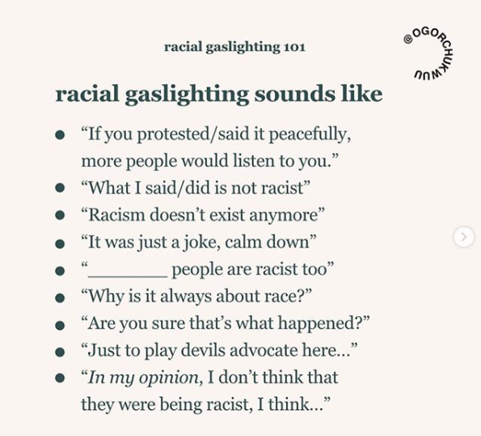
Notes:
Sofia & Candace

Slide 9
Spheres of Influence - Individual Ally
What TO Do
Show up to others in ways that reflect the work you’re doing within
Not enough to just talk about it; have to walk the walk
Inaction is a form of action
Intentionally expand your social network
Notes:
Candace

Slide 10
Small Group Discussion Questions
What are your spheres of influence?
Who are the people you encounter where there might be some sort of emotional investment and consistent interaction?
Breakout room
5 minutes
About 7 people/room
Nominate a spokesperson for your group!
2-3 groups share what they discussed
Notes:
Sofia

Slide 11
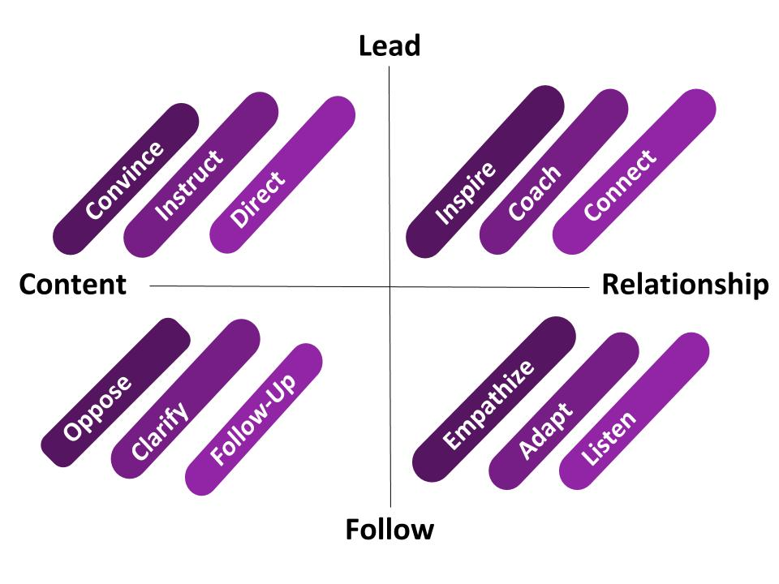
Interacting with Spheres of Influence
Inspired by: https://www.youtube.com/watch?v=CZt3QkRE_SA&feature=youtu.be
Notes:
Candace

Slide 12
Personal Sphere
Active Listening
Ask Questions
Adapt - Unlearn & Relearn
Notes:
Sofia

Slide 13
Personal Sphere Small Group Scenarios
Breakout rooms
10 minutes
About 7 people/room
Situation 1: You bring a friend home that had on a wristband that says “Black Lives Matter”, and your mom notices. After your friend leaves, your mom confronts you and says “I noticed your friend’s BLM wristband. I don’t know how I feel about that. Isn’t that racist? Don’t all lives matter?”
Situation 2: You’re out with your significant other’s family exploring the city, and you notice that there is a large parade going on. You ask if they know what it is for, and the dad replies “Oh, it’s the Puerto Rican Parade. Can’t you tell? They’re all dark.”
Notes:
Sofia

Slide 14
Professional Sphere
Clarify
Oppose
Follow Up
Notes:
Candace

Slide 15
Professional Sphere Small Group Scenarios
Breakout rooms
10 minutes
About 7 people/room
Situation 1: There are two groups visiting campus: one from your Asian-American colleague’s alma mater, and the other from a CBO. The visit coordinator assigns the CBO to your Asian-American colleague. As your colleague comes down to speak with the CBO group, he notices his old counselor from his alma mater walk in with their group of students. He approaches the visit coordinator afterwards and asks why he was not assigned to his alma mater. The visit coordinator responds with “Oh, well I thought you would relate to this group more.”
Situation 2: You overhear a conversation between your colleague and a parent. The parent is requesting that the counselor uses her transgender daughter’s preferred name “Jenny”, as opposed to their dead name “Jonathan”. You hear the counselor say, “are you sure? It may be safest to stick with his real name.”
Notes:
Candace

Slide 16
Rolling Forward
Goal is to be as balanced in our approach to influence
Zero tolerance for racism across all Spheres of Influence
Inaction is a form of action - be intentional!
Bringing diversity into your life on all fronts
Notes:
Sofia & Candace

Slide 17
Contact Information
Candace Leake
Assistant Director
Bucknell University
Candace.Leake@bucknell.edu
Sofia Fallas
Admission Counselor
Saint Joseph’s University
sfallas@sju.edu

Slide 18
Please use the **Evaluation** link
in the chat area to complete the short survey.
You can download the PPT documents from the chat.
**********
SAVE THE DATE!
Promoting Inclusivity & Equity, Lunch & Learn Series
3rd Session: Tuesday, November 17th at 12pm
4th Session: Tuesday, December 15th at 12pm
https://pacac.memberclicks.net/online-workshops

