Slide 1
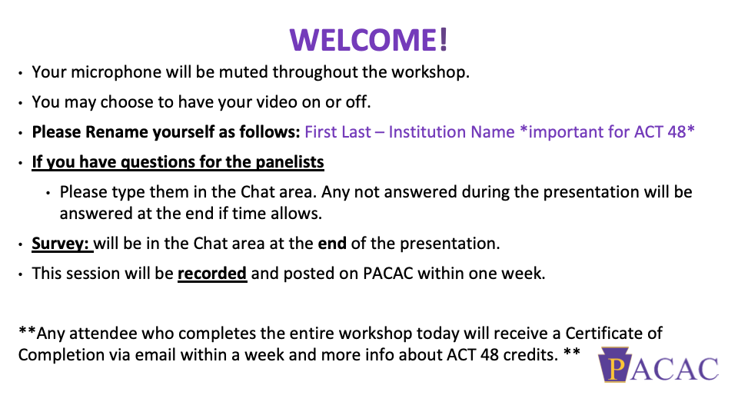

Slide 2


Slide 3
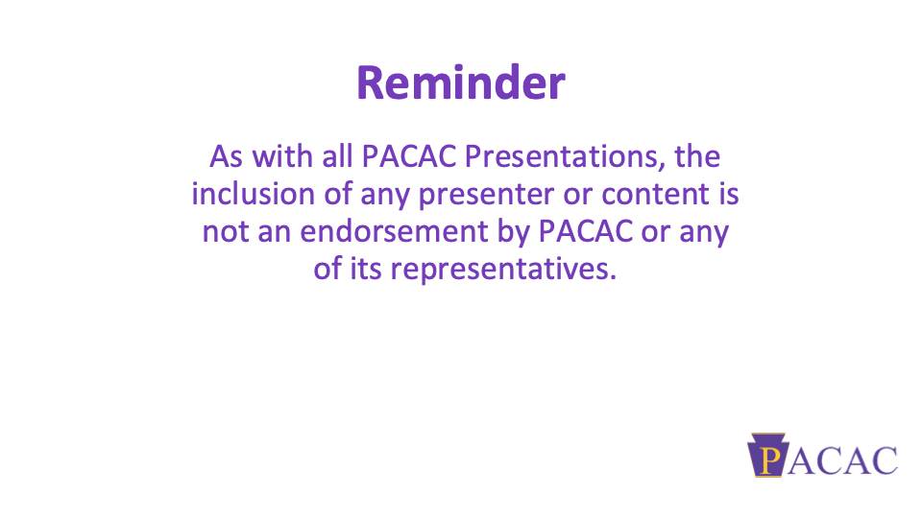

Slide 4


Slide 5


Slide 6
OPENING EXERCISE
Go to www.menti.com
Use the code 2510 1260

Slide 7

College Transition Planning for Students with Learning Differences
"begin with the end in mind" Stephen Covey

Slide 8
DEFINING OUR TERMS
LD - LEARNING DIFFERENCES
difference in the way a person's brain is "wired."
are as smart or smarter than their peers
Dyslexia – a language-based disability in which a person has trouble understanding written words.
Dyscalculia – a mathematical disability in which a person has a difficult time solving arithmetic problems and grasping math concepts
Dysgraphia – a writing disability in which a person finds it hard to form letters or write within a defined space.
Auditory and Visual Processing Disorders – sensory disabilities in which a person has difficulty understanding language despite normal hearing and vision
Nonverbal Learning Disabilities – a neurological disorder which originates in the right hemisphere of the brain, causing problems with visual-spatial, intuitive, organizational, evaluative and holistic processing functions
LD online

Slide 9

EXECUTIVE FUNCTIONING
difficulty with planning, organizing and managing time and space.
has difficulty planning a project
has trouble comprehending how much time a project will take to complete
struggles to tell a story (verbally or in writing); has trouble communicating details in an organized, sequential manner
has difficulty with the mental strategies involved in memorization and retrieving information from memory
has trouble initiating activities or tasks, or generating ideas independently
has difficulty retaining information while doing something with it; e.g., remembering a phone number while dialing
LD online

Slide 10

ADHD
principal characteristics of ADHD are inattention, hyperactivity, and impulsivity
Feeling restless
Blurting out answers before hearing the whole question
Often becoming easily distracted by irrelevant sights and sounds
Often failing to pay attention to details and making careless mistakes
Rarely following instructions carefully and completely losing or forgetting things like toys, or pencils, books, and tools needed for a task
Often skipping from one uncompleted activity to another.
LD online

Slide 11

EVALUATION REPORT
Evaluation is a process that helps parents and schools determine whether a child has a disability
Identification. It will identify children who have delays or disabilities and need special education
Eligibility. It will determine whether a child is a "child with a disability" under the Individuals with Disabilities Education Act (IDEA)
Planning an Individualized Education Program (IEP). It provides information that will help parents and school professionals develop an appropriate IEP for a child.
Instructional strategies. It will help determine effective strategies to help a child learn.
Measuring progress. It establishes a baseline (present level of performance) for measuring a child's educational progress
LD online

Slide 12
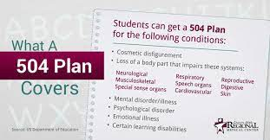
504 PLAN
Covers individuals who meet the definition of qualified "handicapped" person
Does not require that a child need special education to qualify
Does not require an IEP, but does require a plan.
"Appropriate" means an education comparable to the education provided to those students who are not disabled.
Provides related services, if needed.
LD online

Slide 13
IEP /OR OFFICIAL ACCOMMODATION PLAN
IEP (Public)
Each public school child who receives special education and related services must have an Individualized Education Program
The IEP creates an opportunity for teachers, parents, school administrators, related services personnel, and students (when appropriate) to work together to improve educational results for children with disabilities.
Mandated by IDEA (The Individuals With Disabilities Education Act )
Official Accommodation Plan (Private)
a written set of instructions that detail specific strategies and practices that will be used to communicate to teachers what strategies and practices will be used to ensure that a student's learning needs are met.
Not an IEP
Not Mandated by IDEA (The Individuals With Disabilities Education Act )

Slide 14
ACCOMMODATION DIFFERENCES: HIGH SCHOOL/COLLEGE
Postsecondary institutions are required to:
• Make all programs and services physically
accessible to all students
• Provide auxiliary aids, notetakers, and
appropriate equipment
• Accommodate the academic participation of qualified students with disabilities in college classes and activities
Postsecondary institutions are not required to:
• Provide academic modifications that alter the
nature of the course
• Lower admission
• Diagnose a disability or conduct testing
• Provide personal attendants
• Provide personal or private tutors
• Prepare IEPs

Slide 15
Part 2 - So You’re Working With Juniors...
Adolescent Development
&
Academic Maturity
Start of
Another Transition
Point
Junior
Year

Slide 16
Part 2 - Juniors With Learning Differences
May have spent years hiding, and now are being asked new, uncomfortable questions.
May or may not know about their LD and how it impacts their learning.
May or may not know about the impact their accommodations have had on their learning.
May or may not be comfortable with their LD, talking about it, and understanding it.
Likely have had parents in the driver’s seat for many years.
May be feeling a whole lot of anxiety about the college process and may be worried that their process might be “different”.
Junior
Year

Slide 17

Part 2 - Juniors With LDs & Their Parents
Many parents of high school-aged LD students have been advocating for their student for their entire career in school. Let’s think about that for a moment...
We are consistently pushing students to the fore of the college conversation (as we should), but what if the student isn’t quite there yet? What if the parent isn’t quite there yet?
Some parents have knowledge of a college process from their own experience. Parents of students with LD are often worried that this knowledge won’t be useful for their kid and their process.
Parents aren’t going to be able to communicate with disability support offices in college (more on this later), and are worried that their student might not be ready to take on this task.

Slide 18
Part 2 - Core Skill Areas To Work On With Juniors
Advocacy
Asking for help when needed.
Preparing to speak with adults who may or may not understand LDs and their impact on learning.
Awareness
Knowledge of self and LD.
Knowledge of needs that equal success.
Executive Functioning
Developing a specific system for info gathering and weeding through the info onslaught.
Articulation
Speaking about one’s LD in their own words.
Speaking about how LD impacts their learning & class experience.

Slide 19

Part 2 - Questions To Ask Juniors
Can you tell me about your LD in your own words? Skip the evaluation jargon, what is your experience with your LD?
What kinds of accommodations do you find most helpful for you? Why?
What does doing work at home look like for you? How much help from your parents or others are you getting?
If you met a complete stranger for the first time, and had to ask them for help on an assignment, or had to ask them for some accommodation, how would you feel about doing that? What would you say or ask?
How comfortable do you feel asking for yourself, particularly to people you may have just met?
In what kind of space do you prefer to study? (Eg. Library, residence lounge, etc.)
What are some of the accommodations you’ve used in HS? How have those been most helpful to you?
Have you set up a meeting with our Disability Support Office yet? Let me show you where the office is on
campus.

Slide 20

Break Out
How does what you’ve learned in these past few slides impact your practice? What would you change? What would you emphasize more?

Slide 21
Breakout Session #1
▪You will be divided into breakout of approximate equal size (5 to 7 people), and your group will remain the same for both breakouts.
▪You’ll have about 10 minutes to chat with your group.
▪Please pay attention to your breakout room number as we may ask each room to pick a representative that will share with the entire group some of the highlights of your discussion.
▪We encourage you to have your camera on and really lean in to these conversations!

Slide 22
For Those With Large Caseloads
(1)
Caseloads are large in many public high schools which does not always allow as much time to work with students who have learning differences the way counselors would like
Much of the work with students with Learning Differences requires interface with the Special Education teachers and working with 504 and IEP plans
Good idea to bring in people from local colleges or universities to help talk about the transition from high school to college and what students and parents/guardians need to know
Understanding the differences too between IDEA and ADA as well as documentation or information required to make a smooth transition to college
(2)
(3)
(4)

Slide 23
College Search for Students with LD
Questions for Students to Ask Themselves
  Am I ready to begin making independent decisions?
  What am I looking for in a college?
  What kind of support services do I need to be successful?
  Then the more traditional questions as well
    Size
    Location
    Cost/financial aid
    Live on campus vs. commuting
    Majors
    Other characteristics that are important

Slide 24
Important Skills to Have
Advocacy-being able to communicate one’s needs and rights
Academic Skills
Reading and writing
Study Habits
Prepared for class and timely completion of assignments
Personal Skills
Interacting with others in classroom
Social interaction on campus and in residence halls
Ability to accept feedback/criticism/rejection
Independent Living Skills
Knowing medical needs
How to do laundry
Transportation
Executive functioning skills-organizing/time management/initiating tasks

Slide 25
Admission Offices and Helping Students with LD
Training of admission staff is a key component for success in dealing with all students of course, but helping admission staff understand the nuances of LD
Meet with the administrator(s) who run the Office of Student Success or Disability Services to understand the process
Know where the office is on campus and how to help families navigate the process
Get annual updates; invite administrators to Open Houses and other events on campus

Slide 26
What to do after accepted?
Acceptance to college-the language in the ADA is that the student must be “otherwise qualified”
Academic standards in the classroom is the same for all students; instruction is not modified
The college or university is responsible for behavioral standards/codes of conduct for ALL students
Students MUST be able to advocate for self with minimal assistance
Meet with the Office of Disability Services/Student Success
Provide the most updated documentation/testing
Participate in an intake session with the Office personnel to determine reasonable accommodations
The student needs to speak here, not the parent-FERPA applies

Slide 27

Factors in College Success
Resilience
Social Communication and Interaction
Executive Functioning skills
Academic Ability
Thierfeld, Brown 2013

Slide 28
Senior Year --> Preparing for the Transition
Deciding where to enroll
  Meet with Academic/Disability Support Offices in advance
  Understanding grading systems and post-secondary expectations
Parallel preparation
  Traditional college readiness and decision making
  LD support readiness
    How will your academic support be different from high school?
    Accommodation vs Modification
    Residential considerations?
    Executive Functioning plan

Slide 29
Accommodations vs Modifications
ACCOMMODATIONS | MODIFICATIONS
Changing the conditions of an assessment Examples - extended time, recorded audio, typing instead of handwriting Protected by IDEA and ADA Provided in college under ADA | A change in curricular expectations, levels of performance, or means of assessing Examples - fewer questions, waived credit , removal of deadlines, simplified material Generally not provided in college or the workplace
Accommodation vs Waiver/Modification - check college requirements
  Example - foreign language vs culture class

Slide 30
Accommodations in College
Extended Time
  Unlimited time is not realistic
  Deadlines don’t change
Distraction Reduced Testing
  Testing in different/smaller location or testing center
Audio Books
Notetaker or Recorded Lectures
Calculators and computer in class
Residential considerations - medical single room

Slide 31
Documentation Guidelines for College Accommodations
Check individual college websites for exact guidelines
Typically a high school IEP is not sufficient
College disability offices make their own determinations about eligibility and “reasonable accommodations” based on evidence presented in the documentation
Many students get reevaluated/retested after turning 16 years old so that evaluators can use the adult-normed WAIS vs WISC
In-person vs virtual evaluation/testing options as needed

Slide 32
Additional items to consider and prepare before starting
Medication
  What are they taking and when?
  How to refill?
  Interaction with drugs/alcohol? (don’t be afraid of difficult conversations)
Therapy - how to continue existing relationship or find support in new city
Self-advocacy
Independent living
Social pressures and effects on habits
Problem solving - when to reach out and to whom
  academic, social, and emotional resources
Intersectionality - representation matters for retention and success

Slide 33
Break Out
How does what you’ve learned in these past few slides impact your practice? What would you change? What would you emphasize more?

Slide 34
Breakout Session #2
▪You will be divided into breakout of approximate equal size (5 to 7 people), and your group will remain the same for both breakouts.
▪You’ll have about 10 minutes to chat with your group.
▪Please pay attention to your breakout room number as we may ask each room to pick a representative that will share with the entire group some of the highlights of your discussion.
▪We encourage you to have your camera on and really lean in to these conversations!

Slide 35
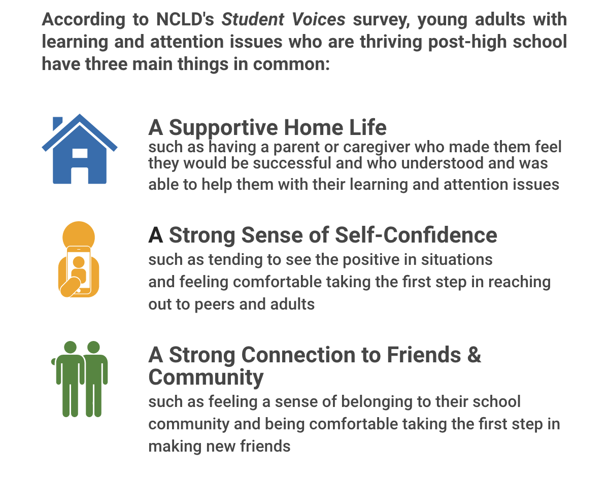
National Center for Learning Disabilities (NCLD)
Source - https://www.ncld.org/research/state-of-learning-disabilities/transitioning-to-life-after-high-school/
Source - https://www.ncld.org/research/state-of-learning-disabilities/transitioning-to-life-after-high-school/
Notes:
Hallie

Slide 36
REFERENCES
Transitioning to Life After High School -NCLD
https://www.ncld.org/research/state-of-learning-disabilities/transitioning-to-life-after-high-school/
National Center for Learning Disabilities (NCLD)
https://ncld.org/
LD Online
http://www.ldonline.org/
Understood
https://www.understood.org/

Slide 37
