Slide 1
Welcome!!
Your microphone will be muted most of the session.
You may choose to have your video on or off.
Please Rename yourself as follows: FirstName LastName – Institution Name
If you have questions for the panelists
Please type them in the chat area. We will do our best to address any not answered during the presentation at the end.
Evaluation & PowerPoint
These will be in the chat area at the end of the presentation.
This workshop will be recorded.
(Link will be posted on the public PACAC website.)
**Any attendee who completes the entire workshop today will receive a Certificate of Attendance via email within a week.

Slide 2
Professional Development, Collaboration, Advocacy, Support, and Friendship

Slide 3
As with all PACAC Presentations, the inclusion of any presenter or content is not an endorsement by PACAC or any of its representatives.
Reminder

Slide 4
Promoting Inclusivity & Equity Lunch & Learn Series
Session I
Joni Klopp, Kutztown University
Catherine Souza, Archmere Academy

Slide 5
“Who we are informs what you do, how you act and interact, and how you see the world around you.” --Dr. Liza Talusan

Slide 6
Our Stories &
What Brought Us to This Work

Slide 7
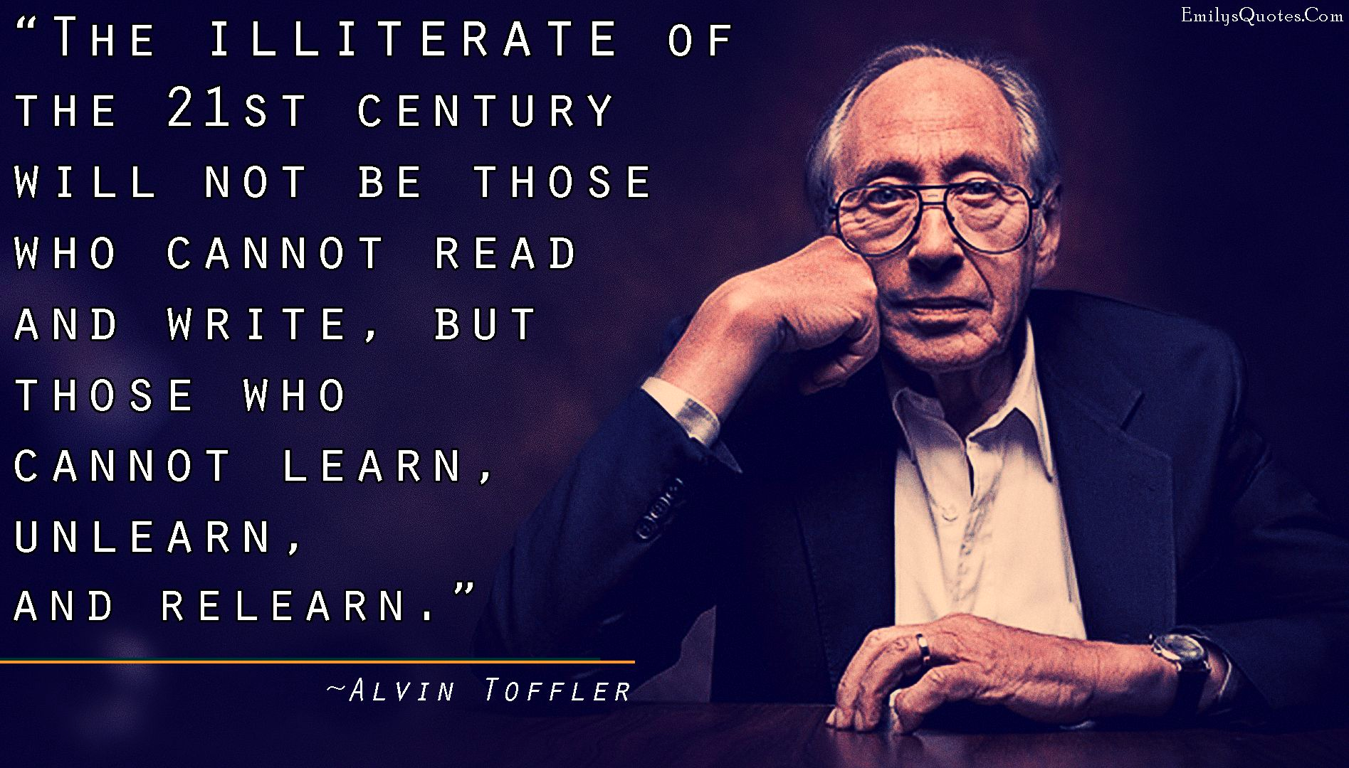

Slide 9
Who are you? Let’s create identity maps

Slide 10
Now, let’s examine each of those parts of you

Slide 11
Small group discussion questions
--What are some ways you identify that might not be apparent to others?
--Did you notice if any “branches” fit into multiple categories?
Breakout rooms
7 minutes
About 7 people/room
Each person shares for about a minute

Slide 12
What is privilege?
The National Conference for Community and Justice defines privilege as “unearned access to resources (social power) that are only readily available to some people because of their social group membership; an advantage, or immunity granted to or enjoyed by one societal group above and beyond the common advantage of all other groups. Privilege is often invisible to those who have it”
Since privilege is often invisible, an important first step is determining if we have it

Slide 13
Privilege Walk
https://www.youtube.com/watch?v=hD5f8GuNuGQ&feature=youtu.be

Slide 14
Privilege Quiz & Self Reflection
If we want to understand our bias, we first need to understand what we bring to the table and privilege is one of the things many of us bring.
Quiz: How privileged are you?
Things to reflect on individually:
What about this exercise surprised me?
What about this exercise made me uncomfortable? Why?
Where there are items on the list I wasn’t aware would be considered privilege?
If the students in my class took this quiz, how might their answers be different?

Slide 15
Implicit Biases
https://www.youtube.com/watch?v=C-GPBq-gGjY

Slide 16
Important things to remember about bias
Bias ART NOT values we have and that we believe—they’re associations that have been formed over many years through a variety of sources.
We have to name them to be able to fight against them.
Project Implicit is one of the ways you can name them—they have many implicit bias tests that will help identify where you might be biased or your blind spots.
Much of our own identity informs how we view others and gives us positive associations or bias.

Slide 17
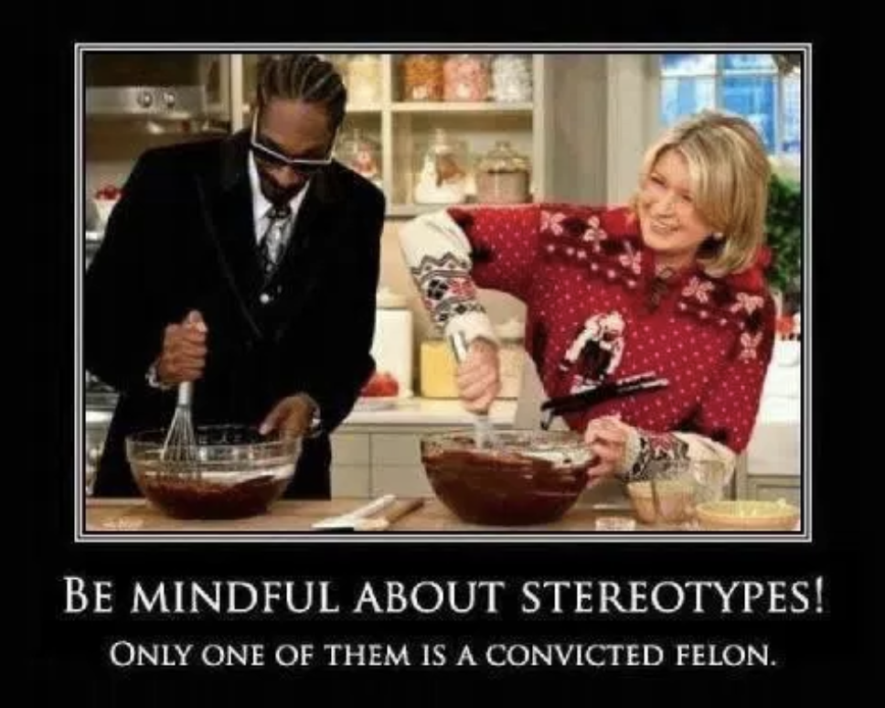
What about stereotypes?
A stereotype is “...a fixed, over generalized belief about a particular group or class of people.” (Cardwell, 1996).
Bias and stereotypes often go hand in hand, but they don’t have to.

Slide 18
What do you see in this picture?

Slide 19
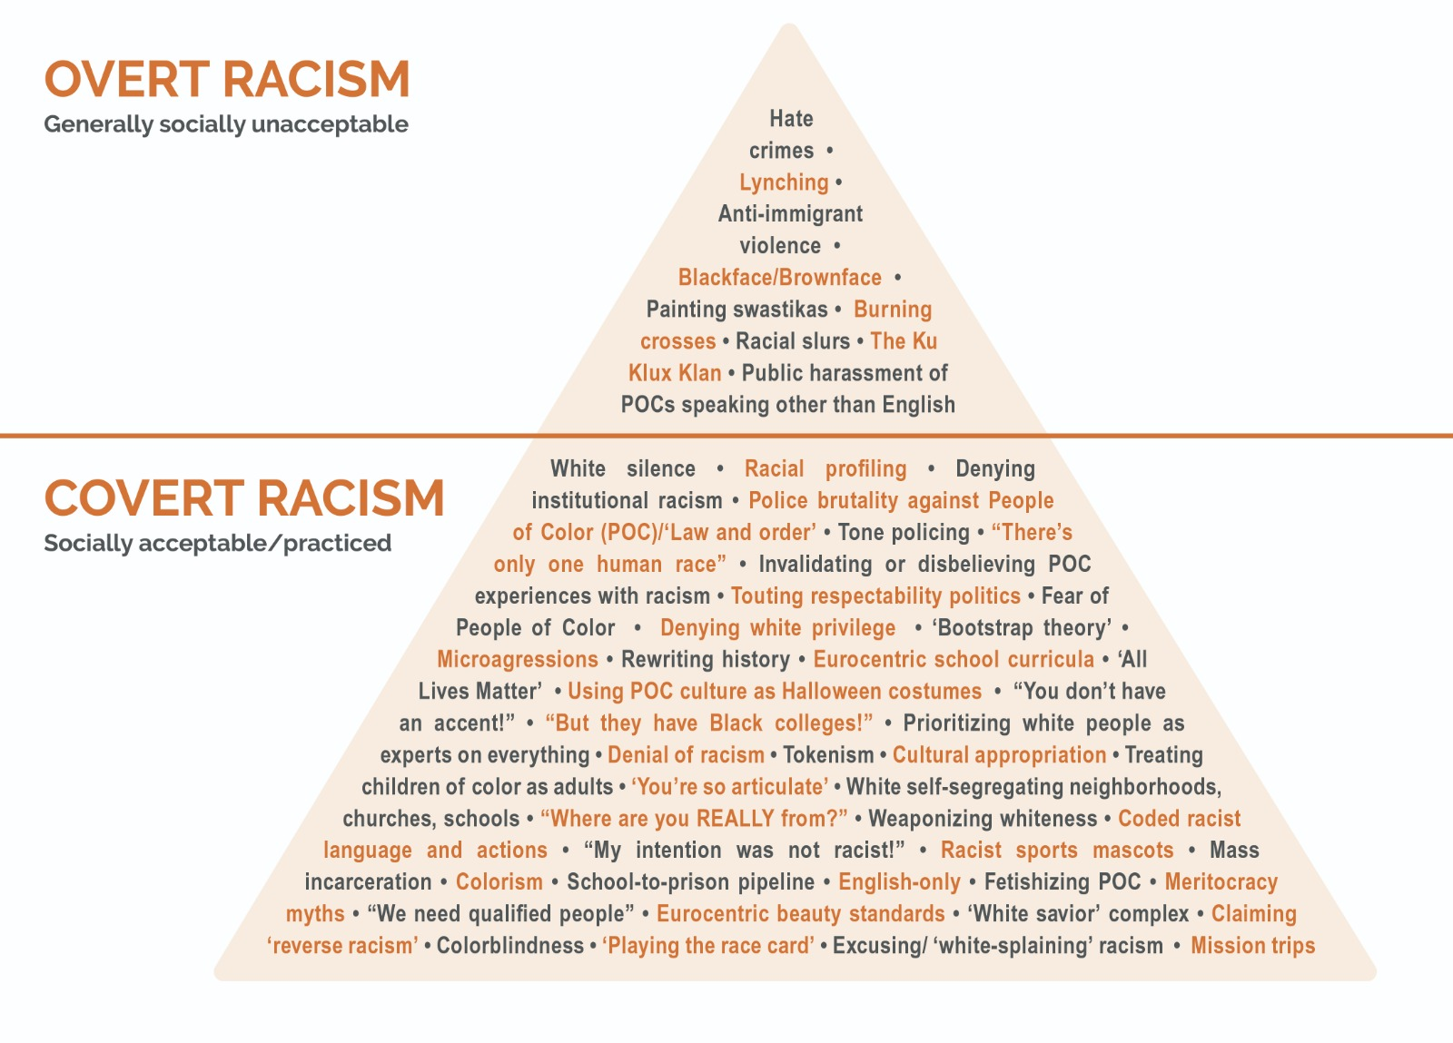

Slide 20
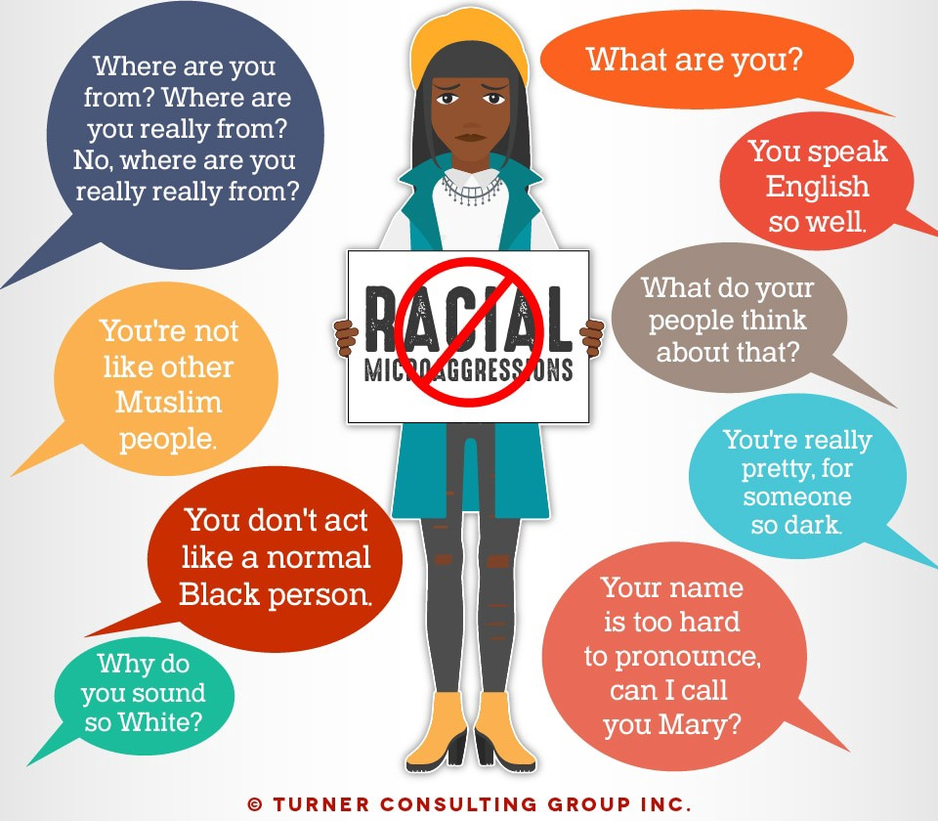

Slide 21
Being Anti-Racist
As an individual, the only thing you can completely control is yourself, your beliefs, and how intentional you are in being anti-racist.
Anti-racist means to actively and intentionally work against racism and the systematic oppression of marginalized groups. It is fundamentally different than simply being “not racist.”
To truly become anti-racist, we must first look within. We must be critical of our privilege, bias, and other things that effect what we believe.
If you are not actively and intentionally anti-racist, you are more than likely benefiting from and complicit in racist systems.

Slide 22
What do I do next?
Continue educating yourself & be intentional with your work
Take one (or a few) of Harvard’s Implicit Association Test (IAT)
Fill your social media platforms with diverse voices and BIPOC
Look at your identity map and find people that don’t share some of your identities (people from different races, genders, sexual orientation, etc.)
Watch the series “Uncomfortable Conversations with a Black Man”
Trust the experiences of others from different backgrounds than you. Just as you know what your truth and lived experience, so do they.

Slide 23
What do I do next?
Be intentional in your self-reflection:
in identifying how and when your privilege comes into play in your life.
in being aware of your own bias and stereotypes you believe.
in identifying covert or subtle racism.
Know that you WILL make mistakes, but we can’t shutdown or stop doing this important work when we make those mistakes. Instead, figure out where you went wrong in your thinking or actions, make it right, and DO BETTER NEXT TIME.

Slide 24
Inclusion Starts with “I”
https://www.youtube.com/watch?v=2g88Ju6nkcg

Slide 25
Contact Information
Catherine Souza
Associate Director of College Counseling
Archmere Academy
csouza@archmereacademy.com
Joni Klopp
Assistant Director of Admissions
Kutztown University of PA
klopp@kutztown.edu

Slide 26
Please use the **Evaluation** link
in the chat area to complete the short survey.
You can download the PPT documents from the chat.
**********
SAVE THE DATE!
Promoting Inclusivity & Equity, Lunch & Learn Series
2nd Session: Tuesday, October 20th at 12pm
3rd Session: Tuesday, November 17th at 12pm
4th Session: Tuesday, December 15th at 12pm
https://pacac.memberclicks.net/online-workshops

