Slide 1
WELCOME!
Your microphone will be muted throughout the workshop.
You may choose to have your video on or off.
Please Rename yourself as follows: First Last – Institution Name *very important for ACT 48*
If you have questions for the panelists
Please type them in the Chat area. Any not answered during the presentation will be answered at the end if time allows.
Evaluation and PowerPoint: will be in the Chat area at the end of the presentation.
This workshop will be recorded.
(Link will be posted in the Members area of the PACAC website.)
**Any attendee who completes the entire workshop today will receive a Certificate of Completion via email within a week and more information on ACT 48 credits. **

Slide 2
Professional Development, Collaboration, Advocacy, Support, and Friendship

Slide 3
As with all PACAC Presentations, the inclusion of any presenter or content is not an endorsement by PACAC or any of its representatives.
Reminder
Notes:
Beginning course details and/or books/materials needed for a class/project.

Slide 4
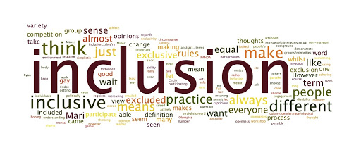
Promoting Inclusivity & Equity Lunch & Learn III November 17, 2020

Slide 5
Presenters
Darryl Jones, Gettysburg College in PA
Michael White, Slippery Rock University of Pennsylvania

Slide 6
What is Inclusion? Equity?
We hear the words often. What do they mean?
How do we make it part of our life, and not just a workshop?
What are some opportunities we can implement in our offices?
Why is it so important?

Slide 7
Why do WE Care?
Let’s see why YOU care in the chat!

Slide 8
Let’s Share in Breakout Rooms!
You will be divided into breakout of approximate equal size, and your group will remain the same.
Please pay attention to your breakout room number.
We’ll ask each room to pick a representative that will share with the entire group some of the highlights of your discussion.
We encourage you to have your camera on and really lean in to these conversations!

Slide 9
Question 1
If you are truly working on DEI, how do you integrate it into your professional life? For example: How many events (pre-Covid OR virtually) do you attend for groups with which you do not share a cultural identity?

Slide 10
Share Your Thoughts
If you are truly working on DEI, how do you integrate it into your professional life? For example: How many events (pre-Covid OR virtually) do you attend for groups with which you do not share a cultural identity?

Slide 11
Question 2
How does your work reflect DEI initiatives with the following?
Admissions: Tour guides, open houses, visit programs, and travel territories
School Counselors: Staff, programming, support
How is success evaluated?

Slide 12
Share Your Thoughts
How does your work reflect DEI initiatives with the following?
Admissions: Tour guides, open houses, visit programs, and travel territories
School Counselors: Staff, programming, support
How is success evaluated?

Slide 13
Question 3
The fervor from spring and summer has dissipated, yet incidents are still happening with regard to racial injustice. What are your plans now that the books have been read, and discussion groups may have ended?

Slide 14
Share Your Thoughts
The fervor from spring and summer has dissipated, yet incidents are still happening with regard to racial injustice. What are your plans now that the books have been read, and discussion groups may have ended?

Slide 15
Privilege
What is it?

Slide 16
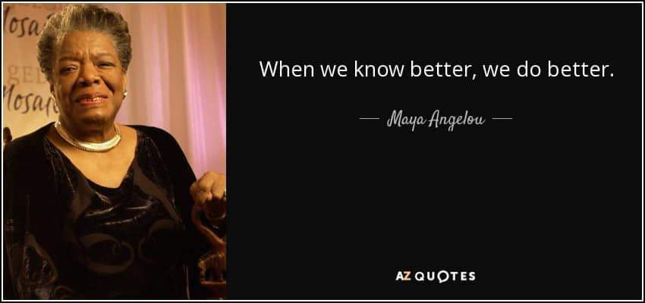
Truth from Maya Angelou
.

Slide 17
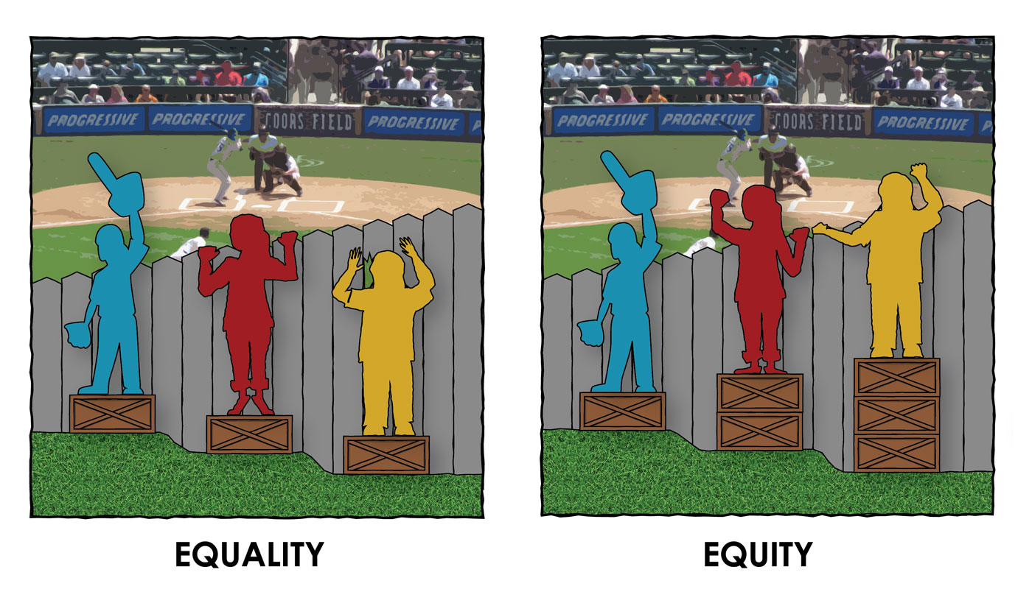
Know the difference…
Which is Which?

Slide 18
Micro? Macro?
Micro-assaults: Similar to overt discrimination, and very deliberate. Example: “We know why YOU were hired…”
Micro-insults: Telling someone that they’re the “exception”. A back-handed compliment with racial implications. Examples: “I don’t mean YOU, but…” or “You’re SO articulate!” or…the following around trick…
Micro-invalidations: Dismissive actions or comments that invalidate the experiences of a member in the underrepresented community. Example: “You are over-reacting. I don’t believe that person would have ever done/said that to you.” “Some of my BEST FRIENDS are (fill in the blank).”

Slide 19
Opportunities and Clarity
Ask for clarification to give them an opportunity to check themselves. Example: Ask “What did you mean when you said ‘I didn’t expect for you to be so articulate’”?
Acknowledge their intentions, but illuminate the impact of their action. Example: Say “I understand that you didn’t mean to be offensive, but when you said you didn’t expect me to be articulate, it was hurtful.”
Foster an inviting conversation. Don’t call people out by hurling an insult, even if it is “just”. Focus on their actual words/actions.

Slide 20
Doing The Work
Essential Questions (Bedelia Nicola Richards, 2018)
1. Which group or groups feel most at home on the campus and which ones feel like (unwanted) guests?
2. Whose norms, values and perspectives does the institution consider to be normal or legitimate? Whose does it silence, marginalize or delegitimize?
3. Who inhabits positions of power within the institution?
4. Whose experiences, norms, values and perspectives influence an institution’s laws, policies and systems of evaluation?
5. Whose interests does the institution protect?

Slide 21
Make a Plan
How are you dismantling barriers in your work regarding DEI? For instance, with travel, how do you determine what is safe, and for whom? For applications, how do you write the proper recommendations, and how do you read them within the context of a student’s life situation?

Slide 22
Read More, Learn More
How to Be an Antiracist Hardcover – August 13, 2019
by Ibram X. Kendi (Author)
Everyday Bias: Identifying and Navigating Unconscious Judgments in Our Daily Lives
by Howard J. Ross (Author)
Biased: Uncovering the Hidden Prejudice That Shapes What We See, Think, and Do Paperback – March 3, 2020
by Jennifer L. Eberhardt PhD (Author)
Unconscious Bias "Turning Unconscious Bias into Conscious Thought": A Book About People Paperback – June 6, 2017
by Phil L. Claybrooke (Author), Harvey Phelps (Author)
Blind spot: Hidden Biases of Good People Paperback – August 16, 2016
by Mahzarin R. Banaji
Use PACAC’s Resources!!!

Slide 23
What are your questions?
We’d like to know what’s on your mind.

Slide 24
Thank you for joining us!
Success is not a workshop and a box to check. It’s daily work in your life. Lean into it!

Slide 25
Keep in Contact!
Michael D. White—Technology Applications Coordinator for Enrollment Management at Slippery Rock University of Pennsylvania michael.white@sru.edu
Darryl W. Jones—Senior Associate Director of Admissions, Coordinator for Multicultural Admission, and Intercollegiate Athletics Liaison at Gettysburg College in PA djones@gettysburg.edu

Slide 26
Please use the **Evaluation** link in the Chat area to complete the short survey.
You can download the PPT documents from the Chat.
This recording will be available on PACAC website in about a week!
SAVE THE DATE!
Promoting Inclusivity & Equity, Lunch & Learn Series
4th Session: Tuesday, December 15th at 12pm
New topics offered 3rd Tuesday of every month in 2021!
https://pacac.memberclicks.net/online-workshops

