Slide 1
WELCOME!
Your microphone will be muted throughout the workshop.
You may choose to have your video on or off.
Please Rename yourself as follows: First Last – Institution Name *very important for ACT 48*
If you have questions for the panelists
Please type them in the Chat area. Any not answered during the presentation will be answered at the end if time allows.
Evaluation and PowerPoint: will be in the Chat area at the end of the presentation.
This workshop will be recorded.
(Link will be posted in the Members area of the PACAC website.)
**Any attendee who completes the entire workshop today will receive a Certificate of Completion via email within a week and more information on ACT 48 credits. **

Slide 2
Professional Development, Collaboration, Advocacy, Support, and Friendship

Slide 3
Reminder
As with all PACAC Presentations, the inclusion of any presenter or content is not an endorsement by PACAC or any of its representatives.

Slide 4
Lunch & Learn Session IV: Influencing Your Local Community & State Toward Inclusivity & Equity
Ian Harkness, Malvern Preparatory School
Joni Klopp, Kutztown University
Notes:
Sofia & Candace

Slide 5
Introductions
Personal/Professional
Why do we do what we do?
Notes:
Sofia & Candace

Slide 6
Breakout Sessions
You will be divided into breakout of approximate equal size, and your group will remain the same.
Please pay attention to your breakout room number.
We’ll ask each room to pick a representative that will share with the entire group some of the highlights of your discussion.
We encourage you to have your camera on and really lean in to these conversations!
Notes:
Sofia & Candace

Slide 7
Breakout Session #1
What challenges regarding DEI have you experienced in your personal and professional life?
How did you approach the situation? Did you know the solution? Did you know who was best to provide help?
Who did you turn to?
Notes:
Sofia & Candace

Slide 8
Advocacy
Advocacy is an activity by an individual or group which aims to influence decisions within politics, economic, and social systems and institutions.
The act or process of supporting a cause or proposal.
Data is helpful, but don’t underestimate the power of personal stories.
You are the expert! Legislators work for you.
Notes:
Sofia & Candace

Slide 9
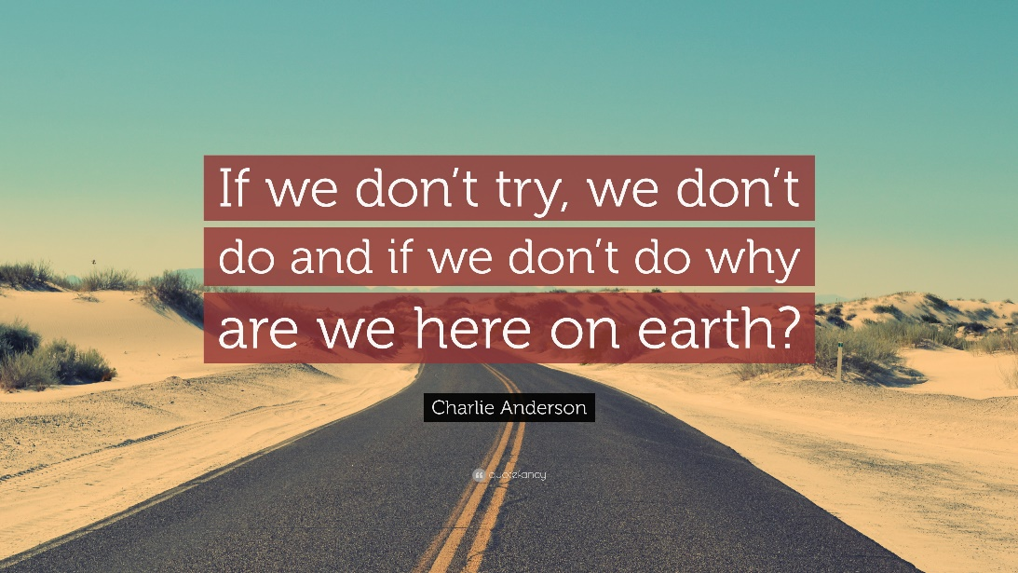
Advocacy
It’s not enough to be pro-cause, you must be anti-discrimination.
You’ve got to get your hands dirty!
Notes:
Sofia & Candace

Slide 10
Breakout Session #2
What now? What is your next action?
Who needs to hear your story?
Notes:
Sofia & Candace

Slide 11
Take-Aways
VOTE! You are their boss!
State/Federal- connect with elected officials in your town
Participate in local school board conversation
Chapter 339- K-12 District Counseling plans/committee
Locate and connect with local powerful community members
Local groups; Western PA College Success Roundtable, Philly College Prep Roundtable, etc.
Action Alerts: emails directly to Harrisburg & DC
PACAC: Advocacy Leadership Credential, Advocacy Days, DEI Subcommittee
Notes:
Sofia & Candace

Slide 12
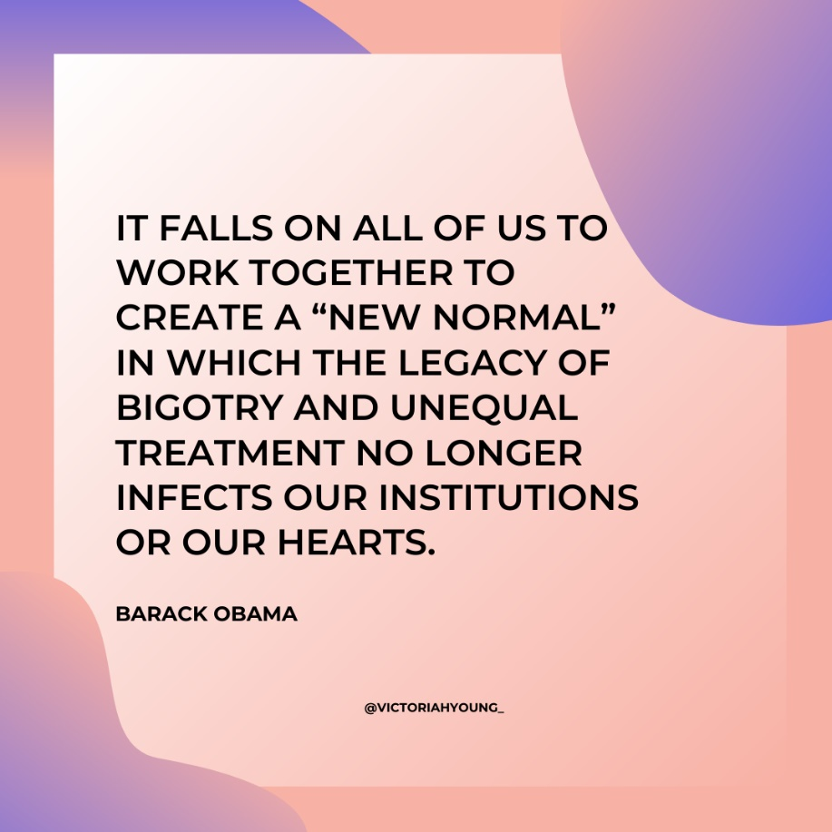
THANK YOU
Notes:
Sofia & Candace

Slide 13
Resources & Helpful Sites
PACAC Government Relations: https://www.pacac.org/government-relations-committee
Advocacy Leadership Credential Program: https://www.pacac.org/ALC-Program
Diversity, Equity, & Inclusion Resources: https://docs.google.com/document/d/15NZgdMjnslOvUjjpXSj2Zeuq1_x-0XdXTZcP6qw3Wns/edit
Find Your Legislators:
PA https://www.legis.state.pa.us/cfdocs/legis/home/findyourlegislator/
DC - House & Senate - https://www.usa.gov/elected-officials

Slide 14
Please use the **Evaluation** link in the Chat area to complete the short survey.
You can download the PPT documents from the Chat.
This recording will be available on PACAC website in about a week!
SAVE THE DATE!
New topics will be offered 3rd Tuesday of every month in 2021!
https://pacac.memberclicks.net/online-workshops

